Slide 1
Farmer Funded Farmer Directed Crop Research

Slide 2
Who is WGRF?
Farmer Funded and Directed
Fund research
Largest producer funder of research in Canada
Diverse membership (18)
Notes:
WGRF is a charitable foundation
Diverse Membership of 18 farm organizations
United by Single Purpose: Invest in Field Crop Research to Benefit Western Canadian Farmers
Not involved in policy or advocacy

Slide 3
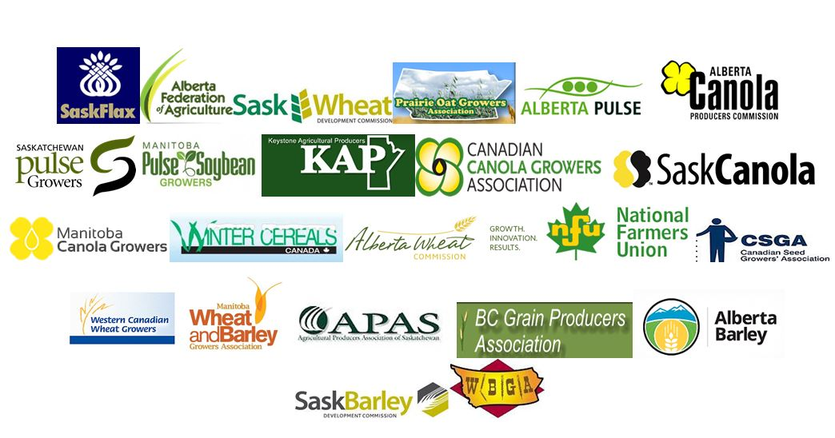
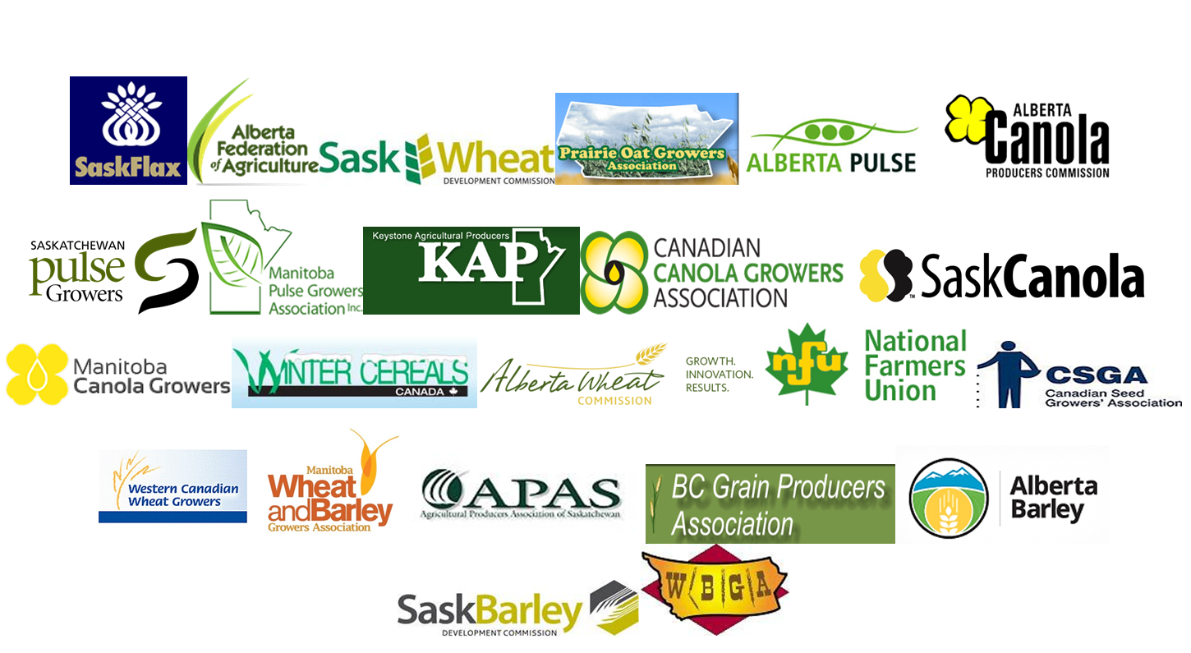

Slide 4
WGRF is Unique
Fund research in all western Canadian field crops
Western Canadian approach to funding
Significant funds available
No policy or marketing
Notes:
WGRF is a charitable foundation
Diverse Membership of 18 farm organizations
United by Single Purpose: Invest in Field Crop Research to Benefit Western Canadian Farmers
Not involved in policy or advocacy

Slide 5
Research
Funding
Notes:
Commitments from all funds (Wheat, Barley, Endowment)
Includes all active contracts and contracts in progress of being developed

Slide 6
Largest Producer Funder of Crop Research in Canada
>$19 million invested in 2015
>250 active projects
Notes:
Five sources of revenue
Endowment Fund
Wheat Check-Off Fund
Barley Check-Off Fund
Investments (and royalties)
Third Party Funds (Growing Forward 2)

Slide 7
WGRF Revenue Sources
Endowment Fund
Wheat Check-Off Fund
Barley Check-Off Fund
Notes:
Commitments from all funds (Wheat, Barley, Endowment)
Includes all active contracts and contracts in progress of being developed
Reported by crop groups

Slide 8
WGRF Committed Funding ($75 M in 2015)

Slide 9
WGRF Committed Funding by Crop ($75M in 2015)

Slide 10
Wheat Research
WGRF has funded wheat breeding programs since 1994
Long term stable funding (5-10 year agreement terms)
Public wheat breeding programs supported:
Agriculture and Agri-food Canada
Universities of Alberta, Saskatchewan and Manitoba
Alberta Agriculture and Forestry
>$10M invested in wheat in 2015
Notes:
Five sources of revenue
Endowment Fund
Wheat Check-Off Fund
Barley Check-Off Fund
Investments (and royalties)
Third Party Funds (Growing Forward 2)

Slide 11
Wheat Breeding Investment
Return on investment study commissioned by WGRF
Very high return on their investment
On average every producer check-off dollar invested into wheat varietal research has returned $20.40 in value to the producer.
Notes:
Commitments from all funds (Wheat, Barley, Endowment)
Includes all active contracts and contracts in progress of being developed
Reported by crop groups

Slide 12
>190 New Public Wheat Varieties Since 1994
Notes:
Five sources of revenue
Endowment Fund
Wheat Check-Off Fund
Barley Check-Off Fund
Investments (and royalties)
Third Party Funds (Growing Forward 2)

Slide 13
WGRF Wheat Quality Research
Breeding programs screen wheat lines for quality traits that meets criteria for new variety registration
Expensive and time consuming
Quality screening occurs later in the breeding cycle
Research investment to improve predictive tests that cost less, require fewer seeds and are higher throughput

Slide 14
WGRF Wheat Quality Research
Molecular marker development for quality traits
Genetic markers for dough strength, protein and loaf volume
Enable breeders to screen large volume of lines for these traits at an early generation
Cull lines that do not contain the quality traits required

Slide 15
WGRF Wheat Quality Research
Fusarium Head Blight
New wheat variety development with improved FHB resistance
Improved management practices
Mycotoxin detection and diagnostics
Storage research

Slide 16
WGRF Wheat Quality Research
Milling performance and flour quality of barley and wheat blends
Levels of ochratoxin in milling quality cereal grains
Influence of genotype, weather and environment on gluten strength of CWRS

Slide 17
Looking Forward
Notes:
Five sources of revenue
Endowment Fund
Wheat Check-Off Fund
Barley Check-Off Fund
Investments (and royalties)
Third Party Funds (Growing Forward 2)

Slide 18
Wheat Research Funding
WGRF will no longer receive the wheat check–off after July 2017
Commissions will absorb the check-off and lead wheat research
WGRF is working closely with the Commissions during the transition
WGRF will manage Core Wheat Breeding Agreements until 2020
Notes:
Commitments from all funds (Wheat, Barley, Endowment)
Includes all active contracts and contracts in progress of being developed
Reported by crop groups

Slide 19
Wheat Cluster Funding
$25 million dollars - Growing Forward 2 Wheat Cluster Program
National program funded over 5 years
Complete on March 2018
50% producer funded
WGRF
Alberta Wheat Commission
Canadian Field Crop Research Alliance

Slide 20
Agriculture Policy Framework
The next round of funding for the Wheat Cluster– Agriculture Policy Framework
Planning is underway and facilitated by WGRF
Align with the National Wheat Strategy
A lead organization has not been chosen
New potential funding partners
Notes:
Five sources of revenue
Endowment Fund
Wheat Check-Off Fund
Barley Check-Off Fund
Investments (and royalties)
Third Party Funds (Growing Forward 2)

Slide 21
Future for WGRF
Producers investing in research for the benefit of western Canadian farmers
Endowment Fund
Agronomy Capacity Study
Western Canadian Approach
Collaboration
Notes:
Five sources of revenue
Endowment Fund
Wheat Check-Off Fund
Barley Check-Off Fund
Investments (and royalties)
Third Party Funds (Growing Forward 2)

